Slide 1
ECE 333 Green Energy Systems
Lecture 11: Maximum Power Point Tracking, Photovoltaic Systems, & Utility Rates
Dr. Karl Reinhard
Dept. of Electrical and Computer Engineering
University of Illinois at Urbana-Champaign
reinhrd2@illinois.edu

Slide 2
Announcements
Quiz on HW 5 today
Exam 1 is on Thursday (1 Mar) in this room
closed book
closed notes
Bring a standard calculator (no smart phones) & one 8.5” x 11” note sheet (front and back) (provided)
Covers material up to PV arrays – but not including dc-dc converters

Slide 3
Dust Degrades PV Panel Performance
Dust degrades PV system performance, degradation can exceed 15%
Dust accumulation depends on many factors
Amount of dust in the environment
Humidity, wind, rain,
Panel tilt, surface finish
Cleaning frequency
Dust attracts dust!
Dust accumulation can be reduced by
Manual cleaning – requires water, time consuming)
Surface treatments
Surface material w/ electrostatic charge to repel dust,
Robotic cleaning systems

Slide 4
PV and Dust: Robots Cleaning the Panels
Robotic solar panel cleaning system
Image: http://www.ecoppia.com/solution/ketura-sun

Slide 5
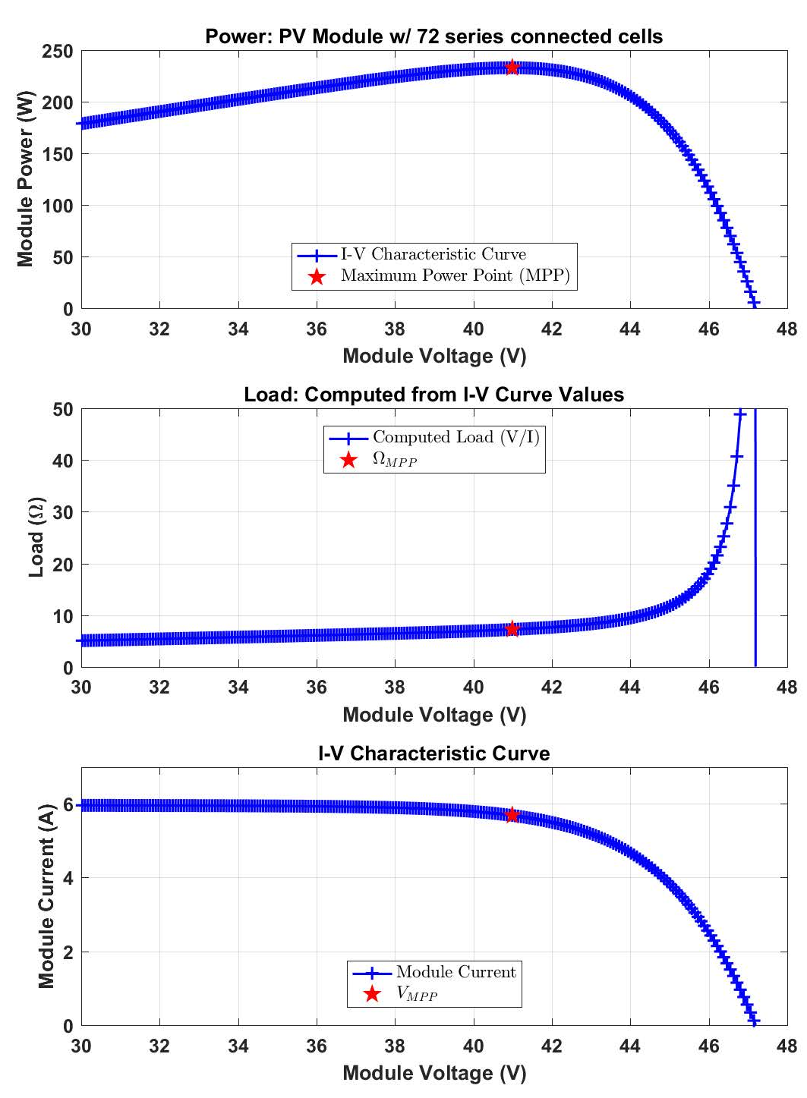
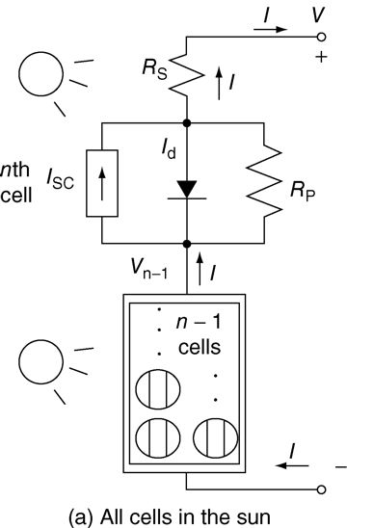
PV Module Operating Point
What Determines the PV Module’s Operating point??
$$R_{load}$$
$$\frac{1}{R_{load}}$$

Slide 6
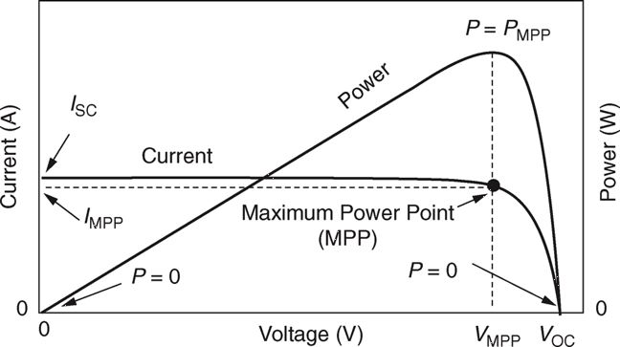
The Need for DC-DC Converters
In general, delivering power from PV source to a load
AC grid – Battery – DC machine
Load Line: $I= \frac{1}{R_{Load}}$ V
Locus of Possible Operating Points
If Load is connected directly across PV terminals,
Operating Point
Since R_{load} is fixed, (V_{L}, I_{L} ) ≠ (V_{M}, I_{M} )
→ Can’t Deliver Max Available Power to the Load
FIGURE 5.40 The I–V curve and power output for a PV module.
Masters, Gilbert M. Renewable and Efficient Electric Power Systems, 2nd Edition. Wiley-Blackwell

Slide 7
The Need for DC-DC Converters (cont)
Need a DC-DC Conversion Circuit:
Load Line: $I= \frac{1}{R_{Load}}$ V
Desired Characteristics:
η→ 100% i.e. V_{M} I_{M} = V_{o} I_{o}
Control Flexibility: As input varies,
Need dc-dc converter to fix operation at MPP
Operating Point
FIGURE 5.40 The I–V curve and power output for a PV module.
Masters, Gilbert M. Renewable and Efficient Electric Power Systems, 2nd Edition. Wiley-Blackwell

Slide 8
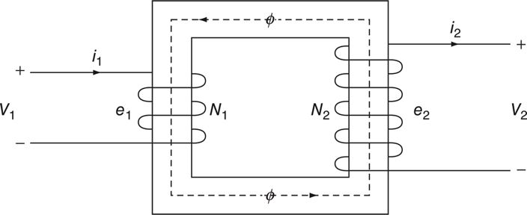
dc-dc Conversion
Consider the Transformer (Lect 5)
Two Issues:
Saturates @ dc
Fixed turns ratio
dc-dc Converter Topologies:
Buck
Boost
Buck-Boost
Composed of:
Energy storage (L, C)
Switches (FET, diode)
Control (digital / analog)

Slide 9
dc-dc Conversion Fundamentals
1. Energy Storage Components
Relevance:
Dc-dc converters include both L and C
Guiding Principles:

Slide 10
dc-dc Conversion Fundamentals
2. Switching Waveform
$<q\left(t\right)> =DT$/T = D
$0≤D≤1$
A “switching signal” controls the dc-dc converter
Average behavior is important to understand dc-dc operation.

Slide 11
Buck dc-dc Converter
Assume an “ideal” diode
Operating Principle:
q(t) = 1, diode is rev biased → off
diode blocks current flow
q(t) = 0, i_{L} requires a path (KCL)
diode is fwd biased → on / conducts

Slide 12
Buck dc-dc Converter
Use $<v_{L}>=0$ to understand circuit behavior
V_{L}(t)
_
+
Switch On
V_{out}(t)
(KVL)
V_{L}(t)
_
Switch Off
+
+
(KVL)
V_{out}(t)
_
If Capacitor C is large, then $V_{out}\left(t\right) \sim constant Vout$
Over a complete q(t) period (switch-on and switch-off cycle):
q(t) = 0, i_{L} requires a path (KCL)
diode is fwd biased → on / conducts

Slide 13
Buck dc-dc Converter
$<q\left(t\right)> =$ D
$(0≤D≤1)$
Applying $<v_{L}\left(t\right)> =0$
As D is controlled, the dc-dc converter delivers V_{out} < V_{in}
q(t) = 0, i_{L} requires a path (KCL)
diode is fwd biased → on / conducts

Slide 14
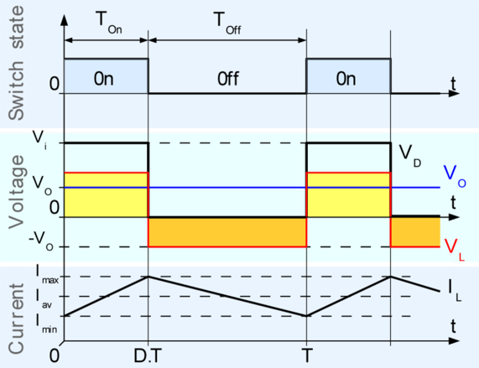
Buck Converter Waveforms
L: Effectively a dc I source (w/ ripple)
C: Effectively a dc V source (w/ ripple)
https://en.wikipedia.org/wiki/Buck_converter
q(t) = 0, i_{L} requires a path (KCL)
diode is fwd biased → on / conducts

Slide 15
Boost dc-dc Converter
Assume an “ideal” diode
Guiding Principle: $<V_{L}> =0$
q(t) = 1, diode is rev biased → off
diode blocks current flow
q(t) = 0, i_{L} requires a path (KCL)
diode is fwd biased → on / conducts

Slide 16
Boost dc-dc Converter
Use $<v_{L}>=0$ to understand circuit behavior
Switch On
(KVL)
Switch Off
(KVL)
Over a complete q(t) period (switch-on and switch-off cycle):
If Capacitor C is large, then $V_{out}\left(t\right) \sim constant Vout$

Slide 17
Boost dc-dc Converter (cont)
$<q\left(t\right)> =$ D
$(0≤D≤1)$
Applying $<v_{L}\left(t\right)> =0$
As D is controlled, the dc-dc converter delivers V_{out} > V_{in}
q(t) = 0, i_{L} requires a path (KCL)
diode is fwd biased → on / conducts

Slide 18
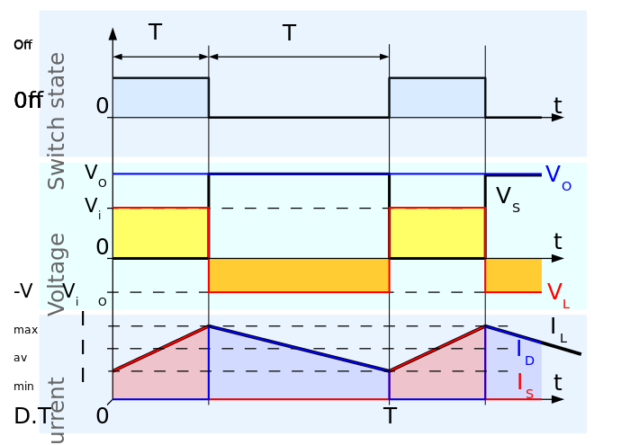
Boost Converter Waveforms
L: Effectively a dc I source (w/ ripple)
C: Effectively a dc V source (w/ ripple)
https://en.wikipedia.org/wiki/Boost_converter
q(t) = 0, i_{L} requires a path (KCL)
diode is fwd biased → on / conducts

Slide 19
Other dc-dc converters
Many converter topologies have been proposed
E.g. flyback, buck-boost, etc.
Each involves $V_{out}=f(D)V_{in}$
Some provide $V_{out}<V_{in} (buck)$
some $V_{out}>V_{in} (boost)$
Others w/o limits (flyback, boost)
ECE 464: Power Electronics
ECE 469: Power Electronics Lab

Slide 20
Fundamental Operational Principles
$<V_{L}> =0, <I_{C}> =0$
Operate in 1 of 2 States:
switch on, diode off
switch off, diode on
Large L, C →
L: Effectively a dc I source (w/ ripple)
C: Effectively a dc V source (w/ ripple)
$$V_{out}=\frac{V_{in}}{(1−D)}$$
$V_{out}=DV_{in} or$
$$0≤D≤1$$

Slide 21
Back to Our “Matching Problem(cont)
Use Conversion Circuit:
Load Line: $I= \frac{1}{R_{Load}}$ V
Match load voltage and PV panel voltage to maximize power conversion
Operating Point
FIGURE 5.40 The I–V curve and power output for a PV module.
Masters, Gilbert M. Renewable and Efficient Electric Power Systems, 2nd Edition. Wiley-Blackwell

Slide 22
(Back to) Maximum Power Point Trackers
Load Line
Maximum Power Point Trackers (MPPTs) are often an integral PV system component, especially grid-connected
Key Idea -- As conditions change, Tuning system’s I-V curve operating point to stay near the “knee”
Buck-boost converter – DC to DC converter, can either “buck” (lower) or “boost” (raise) the voltage
Varying the buck-boost converter’s duty cycle enables the “tuning”
21

Slide 23
MPPTs – Example
A PV module has its MPP @ V_{m} = 17 V, I_{m} = 6A.
What should MPPT duty cycle be if the module is delivering power to a 10 Ω resistive load?
Max power delivered by the PVs is 17V · 6A = 102W
Match Panel V to Load V: Boost PV’s 17 V to Load’s 31.9 V
Solving:

Slide 24
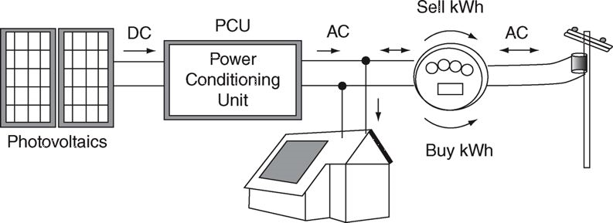
Grid-Connected Systems
FIGURE 6.1 Simplified grid-connected PV system with net metering
Masters, Gilbert M. Renewable and Efficient Electric Power Systems, 2nd Edition. Wiley-Blackwell
Can have a combiner box and a single inverter or small inverters for each panel
Individual inverters make the system modular
Inverter sends AC power to utility service panel
Power conditioning unit (PCU) may include
MPPT
Ground-fault circuit interrupter (GFCI)
Circuitry to disconnect from grid if utility loses power
Battery bank to provide back-up power

Slide 25
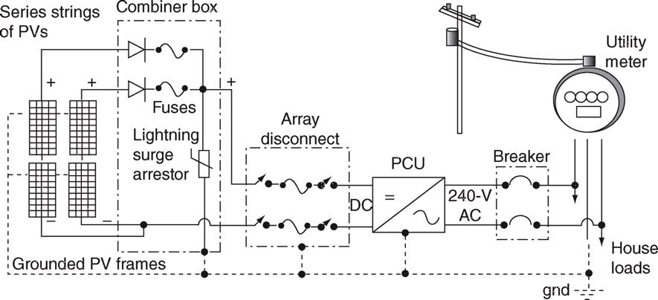
Grid-Connected PV System Components
FIGURE 6.2 Principal components in a grid-connected PV system using a single inverter and a single utility meter.
Masters, Gilbert M. Renewable and Efficient Electric Power Systems, 2nd Edition. Wiley-Blackwell

Slide 26
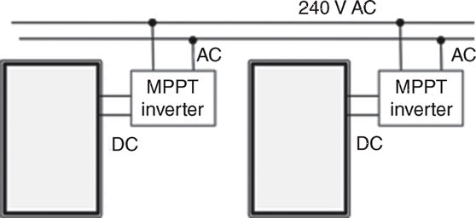
Individual Inverter Concept
Allows easy expansion
House distribution panel connections are simple
Lower $$ -- Less expensive DC cabling required
FIGURE 6.3 An alternative to having a single MPPT/inverter for an entire array is to provide microinverters for each module.
Masters, Gilbert M. Renewable and Efficient Electric Power Systems, 2nd Edition. Wiley-Blackwell

Slide 27
Basic Voltage-Sourced Inverter Operation
Ideally inverter takes a dc input and produces a constant ac frequency output
Output often doesn’t look like a sine ware
Design goal is to minimize the harmonic content
Filters can be used to eliminate harmonics
Figure 6.7 from Elements of Power Electronics by Phil Krein

Slide 28
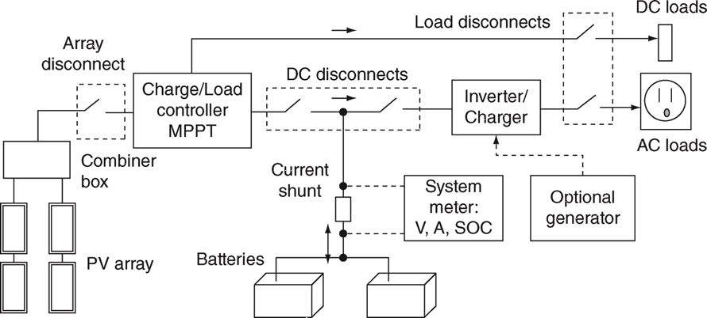
Stand-Alone PV Systems
When the grid isn’t nearby, the extra cost and complexity of a stand-alone power system can be worth the benefits
System may include batteries and a backup generator
FIGURE 6.21 A “one-line” diagram of the important components in a stand-alone PV system.
Masters, Gilbert M. Renewable and Efficient Electric Power Systems, 2nd Edition. Wiley-Blackwell

Slide 29
Stand-Alone PV - Considerations
PV System design begins with an estimate of the loads that need to be served by the PV system
Tradeoffs between more expensive, efficient appliances and size of PVs and battery system needed
Should you use more DC loads to avoid inverter inefficiencies or use more AC loads for convenience?
What fraction of the full load should the backup generator supply?
Power consumed while devices are off
In-rush current used to start major appliances

Slide 30
Electric Utility Rates
Electric utilities long recognized as “natural monopolies” → so their rates set in public (political) process
Also involved an “obligation to serve”
Three main types of utilities:
Investor Owned (IOUs),
Municipals (owned by city) or
Coops (owned by members).
IOUs Rates are set through a process involving state regulators.
Initially bill was based on the number of light bulbs, later replaced by electric meters

Slide 31
Electric Utility Rates, Cont.
W/ 50 states & 1000’s of providers, many rate structures. Simplest – flat rate per kWh….
Many structure possibilities:
fixed charges,
increasing or decreases rates based on amount used,
seasonal and time-of-day rates,
real-time (hourly) pricing,
capacity charges, minimum power factor charges; different for residential, commercial, industrial
Energy may be supplied by a 3d party → Resulting in a transmission, distribution, & energy charge$.
Taxes may abound!!
Which is best? Incremental rates important when considering renewable additions

Slide 32
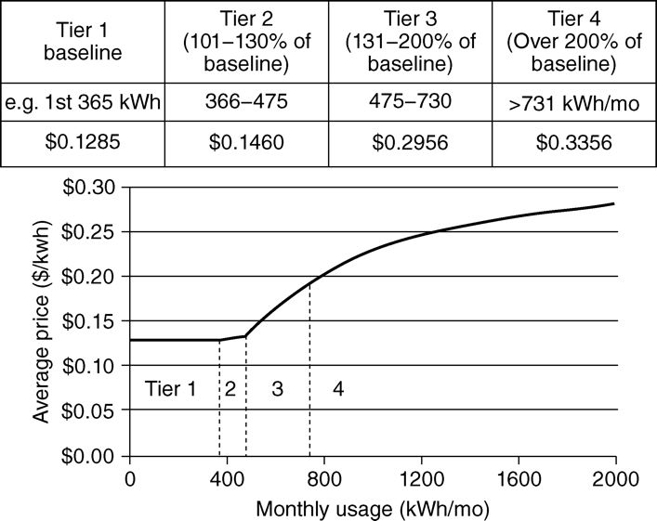
Example PGE Rates (from Section 6.4.4), 2012
FIGURE 6.18 Example of a standard summer residential rate schedule for a California utility. Average consumption for this utility is in Tier 3.
Masters, Gilbert M. Renewable and Efficient Electric Power Systems, 2nd Edition. Wiley-Blackwell

Slide 33
Eastern Illini Electric Coop Rates

Slide 34
Eastern Illini Electric Coop Rates, 2015
Rate 1 (General Service, Single Phase)
Base charge $40 per month
All following charges per
Delivery: 3.767¢/kWh first 1000 kWh, then 1.767¢/kWh
Energy: 3.432 ¢/kWh
Transmission: 1.433 ¢/kWh
Generation: 3.767¢/kWh first 1000 kWh, then 2.647¢/kWh
Total: 12.399 ¢/kWh first 1000 kWh, then 9.279 ¢/kWh
Rate 20 (Electric Heat, Single Phase)
Same categories, base is $50 per month, similar rates in summer (4 months); winter rate >1000 is 7.346 ¢/kWh

Slide 35
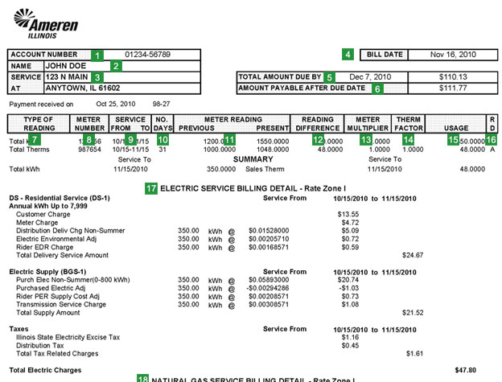
Sample Ameren Bill
https://www.ameren.com/illinois/csc/bill-sample-2

Slide 36
Time of Usage Rates
Some utilities, including Ameren, provide the option to have electricity prices vary hourly
Prices are set day ahead
Prices: https://www2.ameren.com/RetailEnergy/RealTimePrices
Image: http://www.citizensutilityboard.org/pdfs/ConsumerInfo/AmerenPowerSmart.pdf

Slide 37
Commercial and Industrial Rates
Usually commercial and industrial rates also include a "demand charge" that is based on the maximum amount of power used during a time period
Demand charge value is usually measured over some time period, such as 15 minutes
It can also be time dependent, such as different values for summer and winter
Because of the demand charge, the rates paid by commercial and industrial users are lower

Slide 38
CWLP Rates (Springfield, IL) (2012)
Residential, general: $4.67 monthly, $0.0988/kWh Winter, $0.114/kWh Summer
Some seniors (62 up) get about a 10% discount
Residential, all electric: $4.67 monthly, $0.0895 Winter, $0.114 Summer
Small Business: $8.38 monthly, $0.095 Winter, $0.1034 Summer, Demand Charge $8/kW Winter, $9.68/kW Summer
Large Industrial: $577.13 monthly, $0.0722 Winter, $0.0781 Summer, Demand Charge: $11.46/kW Winter, $14.63/kW Summer
Source: http://www.cwlp.com/customer/rates/elecres.html

Slide 39
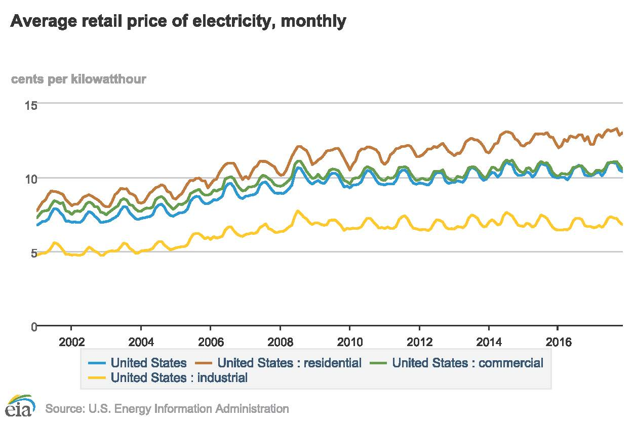
US Average Electricity Rates (Feb 2018)
Image: https://www.eia.gov/electricity/data/browser/#/topic/7?geo=g&agg=0,1&endsec=vg accessed 21 Feb 18

Slide 40
Net Metering for Renewables
Issue with small scale renewables is whether the generated electricity is sold back to the utility at the retail rate or the lower wholesale (avoided cost rate)
Net metering allows the customer to offset their own electric usage, and sometimes sell power back to the utility at the specified retail rate (meter runs backwards)
Requirements for net metering by IOUs are often set by the states; municipals and coops are self-governing
Potential concern about utilities providing services with costs born by the other customers

Slide 41
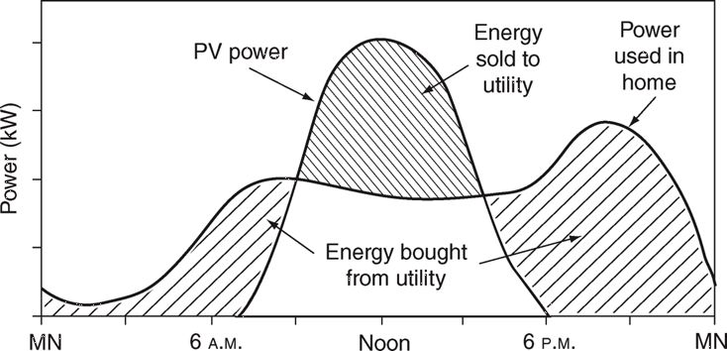
Net Metering for Renewables
Typical residential situation w/ a single meter – Note: meter runs backwards when PV power produced exceeds local usage
During the day, any excess power from the array is sold to the utility; at night, power is purchased from the utility.
Masters, Gilbert M. Renewable and Efficient Electric Power Systems, 2nd Edition. Wiley-Blackwell

Slide 42
Feed-in Tariffs
With feed-in tariffs there are two separate meters, one measuring the household consumption and a separate one measuring the PV generation
This allows the possibility that PV generation can be purchased at quite high rates
Feed-in tariffs started in Europe, but are now used some in the US (website http://www.pv-tech.org/tariff_watch/list summarizes them)
Current ones in Germany are $0.19/kWh for less than 10 kW, $0.18 for between 10 and 40 kW; on Hawaii it is $0.218/kWh for less than 20 kW

